Slide 1
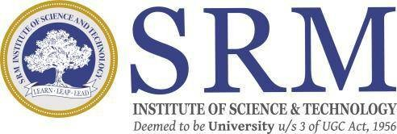
Real-Time Object Detection and Distance Mapping
SRM INSTITUTE OF SCIENCE AND TECHNOLOGY
SCHOOL OF COMPUTING
DEPARTMENT OF COMPUTING TECHNOLOGIES
18CSP109L - MAJOR PROJECT
Batch ID: 1
Student 1 Reg. No: RA2111003011009
Student 1 Name: KINTHALI SAKETH
Student 2 Reg. No: RA2111003011033
Student 2 Name: PUDI SAI KRISHNA
Guide name: Dr. V. Raghavendra
Designation: Assistant Professor Department: Computing Technologies

Slide 2
Abstract
The "Real-Time Object Detection and Distance Mapping" project is an intelligent vision system that can detect, identify, and calculate the relative distance of objects in the context of real-world scenarios. The project makes use of the YOLOv8 deep learning framework, which boasts high accuracy and is capable of delivering real-time performance, to identify differing objects within stationary images and ongoing video streams. Using calibrated focal lengths and object size estimations, the system calculates the physical distance of the detected objects from the camera to a high degree of accuracy.
The system consists of several modules: video-based multi-object tracking with distance annotations, static image object detection, and webcam monitoring in real time with integrated audio feedback. Bounding box detection, centre point detection, pixel-to-meter translation, and visual feedback overlays are used for processing video input in real time, while an optionally integrated text-to-speech interface delivers auditory warnings for users based on their proximity to safety thresholds. The multi-feedback mode offers increased situational awareness and availability for users, including potential benefits for visually impaired individuals.

Slide 3
Introduction
Computer vision has seen dramatic improvement with advances from deep learning-based object detection models. Among these, YOLO (You Only Look Once)-based models have emerged as the de facto choice for object detection in real time, offering an optimum trade-off between speed and precision. While object detection provides a system with the ability to detect and localize an object within a scene, it lacks the ability to perceive spatial relationships among the detected object and the camera. This shortcoming is overcome by distance mapping, providing invaluable spatial insight that helps improve decisions across applications from autonomous systems to assistive technologies for humans.
The "Real-Time Object Detection and Distance Mapping" project is one that brings these two fundamental abilities together to form an integrated, real-time system. The project utilizes YOLOv8, also one of the newer versions of the YOLO system, for object detection, which is characterized by its lightweight design, high-speed inference, and high accuracy, ideal for use for real-world applications on commodity hardware without the need for costly GPUs.

Slide 4
Existing System
Currently, many existing systems focus on either object detection or distance estimation, but few combine both features in a seamless, real-time manner. For object detection, popular deep learning models like YOLO, SSD, and Faster R-CNN are commonly used. These models are highly effective at detecting objects in images and videos, with YOLO being particularly favored for its speed and efficiency. It’s widely used in applications like autonomous vehicles and surveillance systems. However, while these systems are great at identifying objects, they don't typically offer any information about how far away those objects are from the camera.
When it comes to estimating distances, existing solutions usually rely on specialized hardware such as LIDAR, stereo vision cameras, or structured light systems. While these technologies can provide accurate distance measurements, they tend to be expensive, complex, and often require high-powered hardware to function in real-time. Some systems use depth estimation models or stereo cameras to calculate distances, but these methods can be computationally expensive and may not always work reliably in fast-moving or dynamic environments.

Slide 5
Problem statement and Objectives
In today’s world, many technologies rely on being able to detect and understand objects around them. While models like YOLO have made huge strides in quickly identifying objects in real time, they still face a big limitation: they can’t tell us how far away these objects are from the camera or sensor. This lack of spatial awareness creates problems in areas where knowing the distance to an object is crucial—like in autonomous driving, safety systems, and assistive technologies.
Self-driving cars need to not only detect pedestrians or other vehicles but also understand how far away they are to avoid crashes.
Assistive technology for visually impaired individuals could be much more helpful if it could detect objects in their path and tell them how close those objects are, helping them move around more safely.
Industrial systems that track equipment and people need to know how close objects are to each other to avoid accidents and optimize operations.

Slide 6
Problem statement and Objectives
The goal of the "Real-Time Object Detection and Distance Mapping" project is to create a system that not only detects objects quickly and accurately but also estimates how far those objects are from the camera or sensor, all in real time. By using the YOLOv8 deep learning model, the system can identify various objects—like people, vehicles, or obstacles—and then calculate their distance using methods like pixel-to-meter scaling and focal length estimation. This will give a clearer understanding of the environment, making it easier to interact with and respond to what's around you.
The system will provide both visual and auditory feedback. It will display the location of detected objects through bounding boxes and also use text-to-speech technology to warn users when objects are getting too close. This is particularly useful in scenarios like autonomous driving, helping visually impaired individuals navigate, or improving safety in industrial settings—any situation where knowing the proximity of objects can help make better, safer decisions.

Slide 7
Proposed System
The proposed system for the "Real-Time Object Detection and Distance Mapping" project aims to bridge the gap between object detection and spatial awareness in a way that is both efficient and accessible. Using the YOLOv8 deep learning model, the system will be able to detect objects in real time, such as people, vehicles, or obstacles, within images or video streams. This real-time detection will be combined with a unique feature: distance estimation. By using geometric methods like pixel-to-meter scaling and focal length estimation, the system will calculate the physical distance between the detected objects and the camera, providing valuable spatial awareness.
In addition to identifying objects and calculating their distances, the system will offer both visual and auditory feedback. Visual feedback will be provided through bounding boxes around detected objects, allowing users to see their locations clearly. For added accessibility, particularly for visually impaired users, the system will also incorporate a text-to-speech feature that gives real-time audio alerts about the proximity of objects. This makes it especially useful in assistive technologies, autonomous navigation, and industrial safety, where being aware of nearby objects in real time is critical.

Slide 8
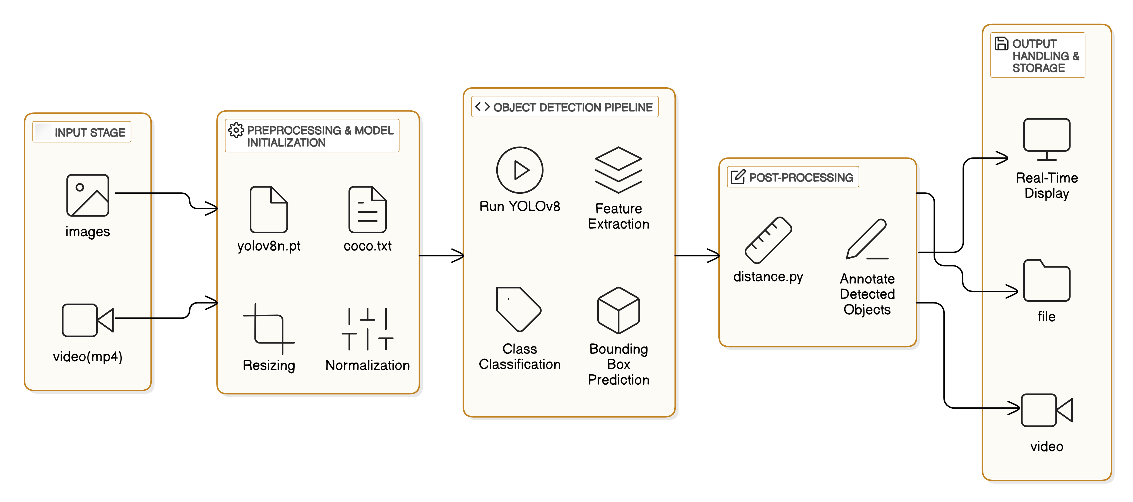
Architecture Diagram

Slide 9
References
[1] Appiah, Emmanuel Owusu, and Solomon Mensah. "Object detection in adverse weather condition for autonomous vehicles." Multimedia Tools and Applications 83, no. 9 (2024): 28235-28261.
[2] Yeong, De Jong, Gustavo Velasco-Hernandez, John Barry, and Joseph Walsh. "Sensor and sensor fusion technology in autonomous vehicles: A review." Sensors 21, no. 6 (2021): 2140.
[3] Sarasa-Cabezuelo, Antonio. "Prediction of rainfall in Australia using machine learning." Information 13, no. 4 (2022): 163.
[4] Wason, Ritika, Parul Arora, Vishal Jain, Devansh Arora, and M. N. Hoda. "Exploring the Convergence of Artificial Intelligence and Mechatronics in Autonomous Driving." Computational Intelligent Techniques in Mechatronics (2024): 297-316.
[5] Ghintab, Shahad S., and Mohammed Y. Hassan. "Localization for self-driving vehicles based on deep learning networks and RGB cameras." International Journal of Advanced Technology and Engineering Exploration 10, no. 105 (2023): 1016.

Slide 10
References
[6] Hasanujjaman, Muhammad, Mostafa Zaman Chowdhury, and Yeong Min Jang. "Sensor fusion in autonomous vehicle with traffic surveillance camera system: detection, localization, and AI networking." Sensors 23, no. 6 (2023): 3335.
[7] Hacohen, Shlomi, Oded Medina, and Shraga Shoval. "Autonomous driving: A survey of technological gaps using google scholar and web of science trend analysis." IEEE Transactions on Intelligent Transportation Systems 23, no. 11 (2022): 21241-21258.
[8] Mahima, KT Yasas, Asanka G. Perera, Sreenatha Anavatti, and Matt Garratt. "Toward robust 3d perception for autonomous vehicles: A review of adversarial attacks and countermeasures." IEEE Transactions on Intelligent Transportation Systems (2024).
[9] Huang, Kun, Yifu Wang, Si'ao Zhang, Zhirui Wang, Zhanpeng Ouyang, Zhenghua Yu, and Laurent Kneip. "OpenGV 2.0: Motion prior-assisted calibration and SLAM with vehicle-mounted surround-view systems." arXiv preprint arXiv:2503.03230 (2025).
[10] Yan, Shen, Maojun Zhang, Yang Peng, Yu Liu, and Hanlin Tan. "Agenti2p: Optimizing image-to-point cloud registration via behaviour cloning and reinforcement learning." Remote Sensing 14, no. 24 (2022): 6301.

